Slide 1

10만 전자 가즈아
6팀 PL 정기호
김명근
김혜진
신문혁

Slide 2
CONTENTS
1
2
리서치 요약
탐색적 데이터 분석
3
4
모델링 / 튜닝 / 검증
[Prophet / ARIMA]
시사점 및 결론

Slide 3

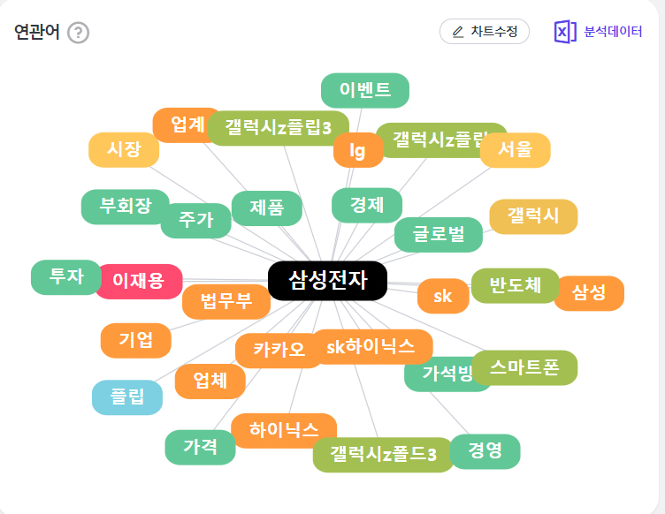
CONTENTS_1
CONTENTS_2
CONTENTS_3
CONTENTS_4
1. 리서치 요약 :
SAMSUNG Word_Cloud

Slide 4
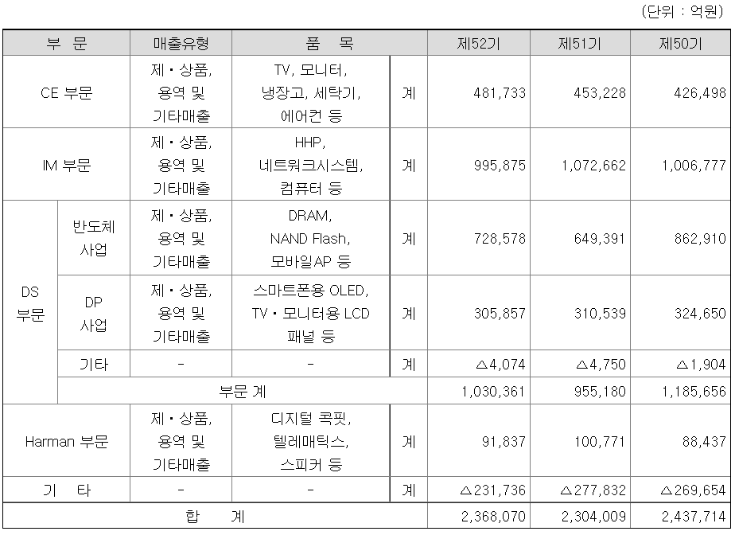
CONTENTS_1
CONTENTS_2
CONTENTS_3
CONTENTS_4
1. 리서치 요약
삼성전자 사업보고서/2021.03.09
Notes:
Ce : customer electronic : 소비자 가전
IM : IT, MOBILE
DS : Device Solution

Slide 5
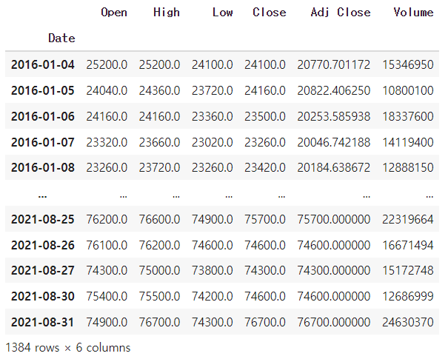
CONTENTS_1
CONTENTS_2
CONTENTS_3
CONTENTS_4
2. 탐색적 데이터 분석
[ Data ]

Slide 6
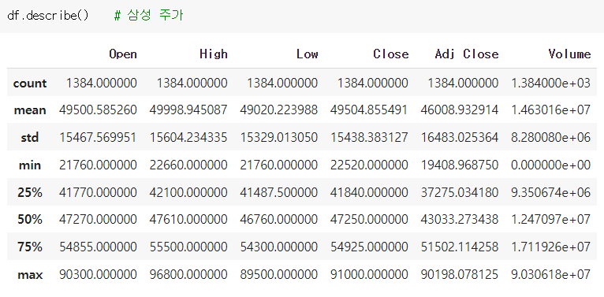
CONTENTS_1
CONTENTS_2
CONTENTS_3
CONTENTS_4
2. 탐색적 데이터 분석
[ Data ]

Slide 7
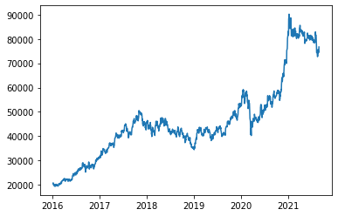
CONTENTS_1
CONTENTS_2
CONTENTS_3
CONTENTS_4
2. 탐색적 데이터 분석
[ Data Plot ]

Slide 8
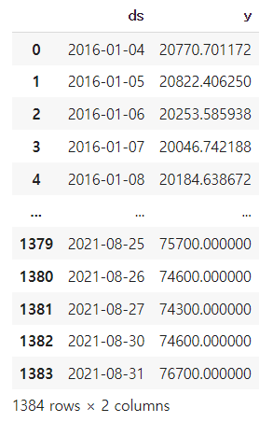
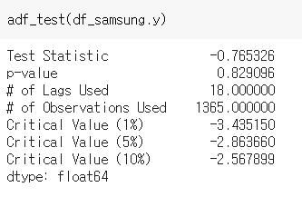

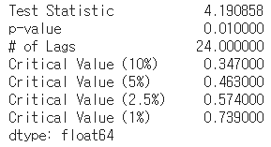
CONTENTS_1
CONTENTS_2
CONTENTS_3
CONTENTS_4
3. Prophet
[ 열 변환 ]
[ ADF Test ]
>>>
[ KPSS Test ]

Slide 9


CONTENTS_1
CONTENTS_2
CONTENTS_3
CONTENTS_4
3. Prophet
[ Data Set 설정 ]
[ Prophet Model 설정 ]
[ 1 Month 예측 ]

Slide 10
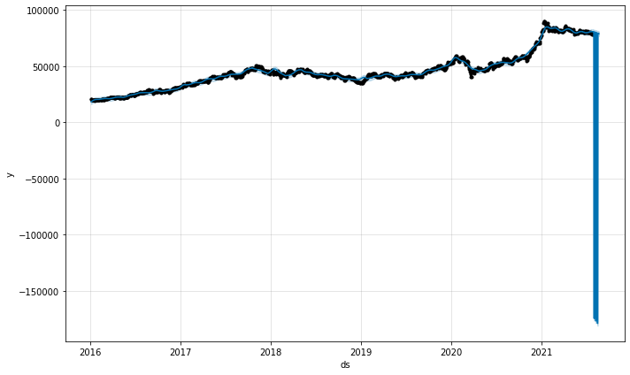
CONTENTS_1
CONTENTS_2
CONTENTS_3
CONTENTS_4
3. Prophet
[ 1 Month 예측 결과 ]

Slide 11
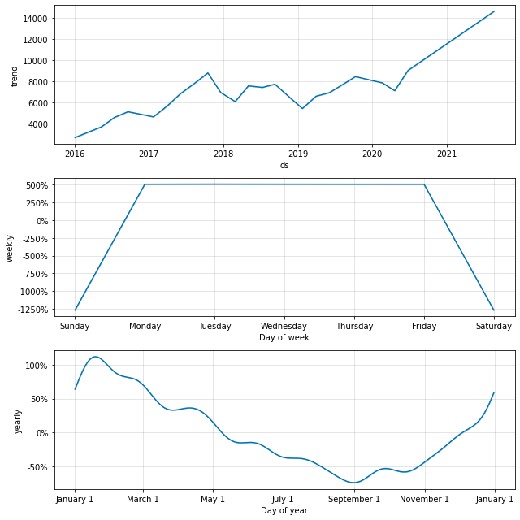
CONTENTS_1
CONTENTS_2
CONTENTS_3
CONTENTS_4
3. Prophet
[ 1 Month 예측 결과 ]

Slide 12
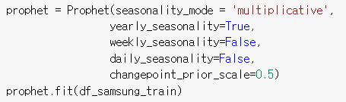
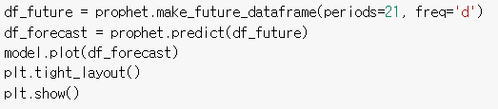
CONTENTS_1
CONTENTS_2
CONTENTS_3
CONTENTS_4
3. Prophet
[ weekly seasonality False 로 Prophet Model 설정 ]

Slide 13
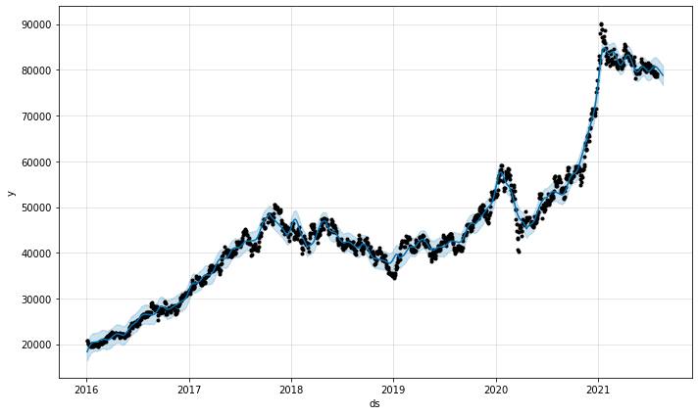
CONTENTS_1
CONTENTS_2
CONTENTS_3
CONTENTS_4
3. Prophet
[ 1 Month 예측 결과 : weekly seasonality False]

Slide 14
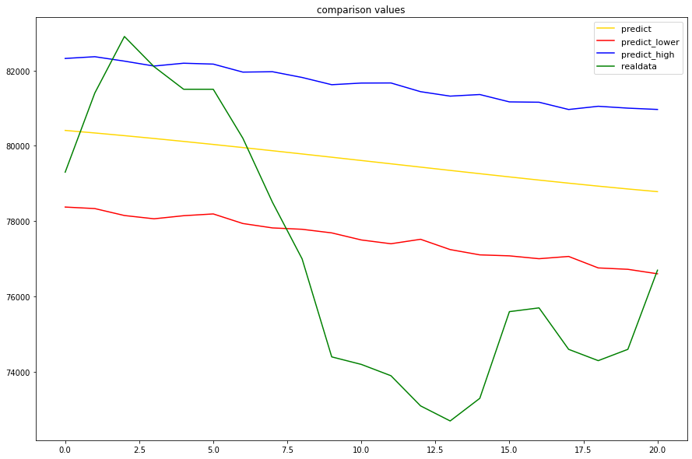
CONTENTS_1
CONTENTS_2
CONTENTS_3
CONTENTS_4
3. Prophet
[ 1 Month 예측 결과 : weekly seasonality False]

Slide 15
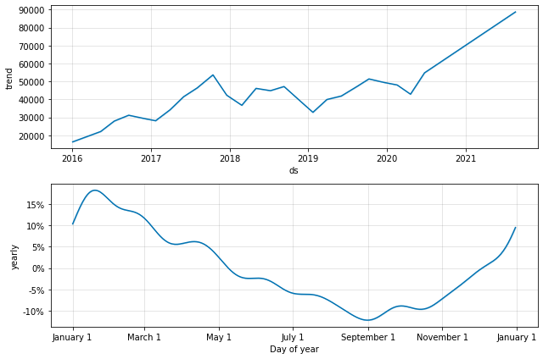
CONTENTS_1
CONTENTS_2
CONTENTS_3
CONTENTS_4
3. Prophet
[ 1 Month 예측 결과 : weekly seasonality False]

Slide 16
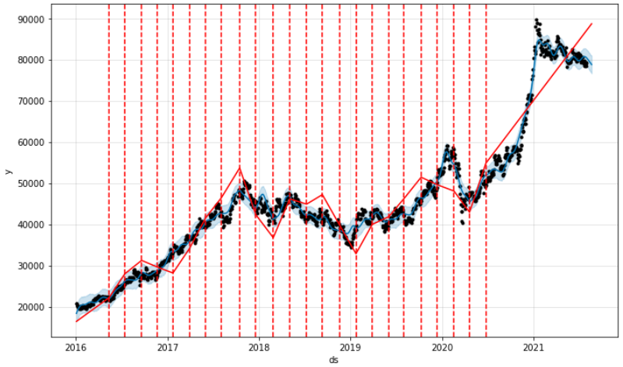
CONTENTS_1
CONTENTS_2
CONTENTS_3
CONTENTS_4
3. Prophet
[ Change Point ]

Slide 17
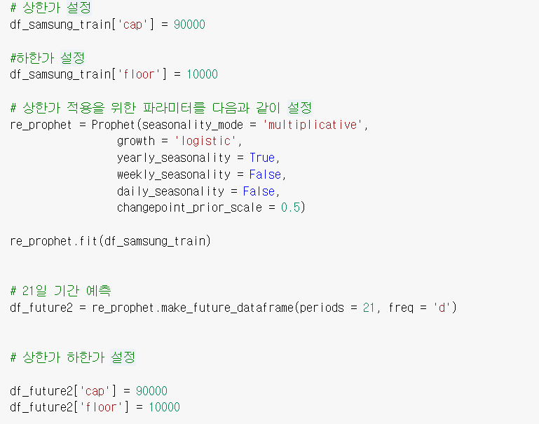
CONTENTS_1
CONTENTS_2
CONTENTS_3
CONTENTS_4
3. Prophet
[ 결과치 조정 – 상한가 및 하한가 설정 ]

Slide 18
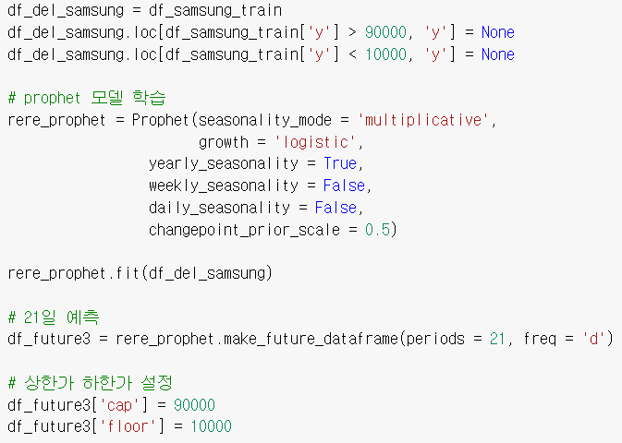
CONTENTS_1
CONTENTS_2
CONTENTS_3
CONTENTS_4
3. Prophet
[상한선 하한선 데이터 제거]

Slide 19
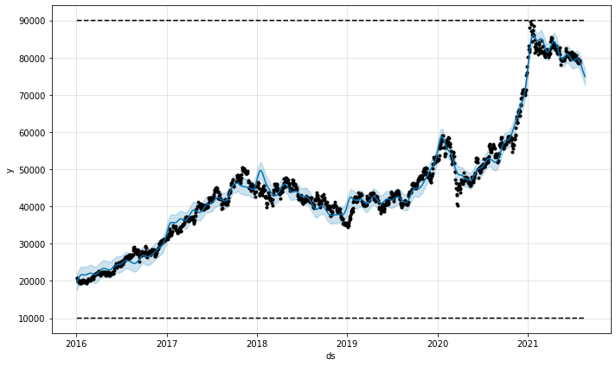
CONTENTS_1
CONTENTS_2
CONTENTS_3
CONTENTS_4
3. Prophet
[ 상한선 하한선 데이터 제거 plot ]

Slide 20
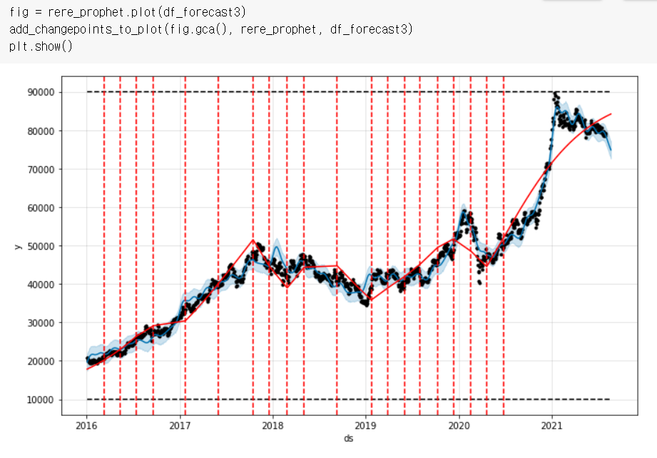
CONTENTS_1
CONTENTS_2
CONTENTS_3
CONTENTS_4
3. Prophet
[Outlier 설정 후 Changepoint 설정 ]

Slide 21
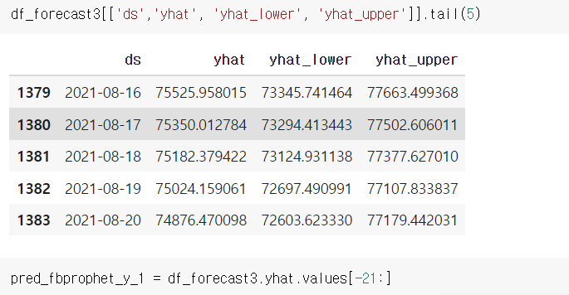
CONTENTS_1
CONTENTS_2
CONTENTS_3
CONTENTS_4
3. Prophet
[1 Month 예측 결과 : 상한선 하한선 데이터 제거 ]

Slide 22
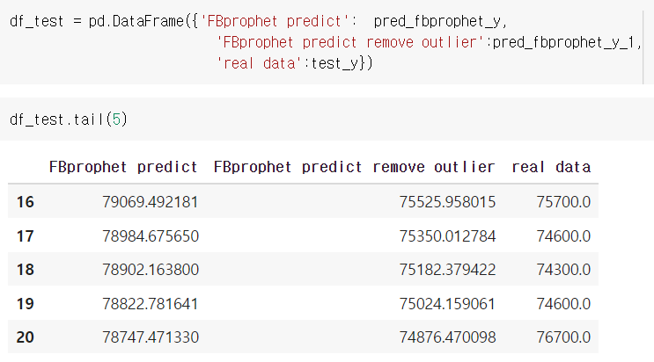
CONTENTS_1
CONTENTS_2
CONTENTS_3
CONTENTS_4
3. Prophet
[ 결과 비교 분석 ]

Slide 23
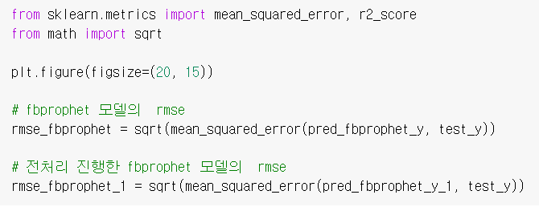
CONTENTS_1
CONTENTS_2
CONTENTS_3
CONTENTS_4
3. Prophet
[ RMSE 검증 ]

Slide 24
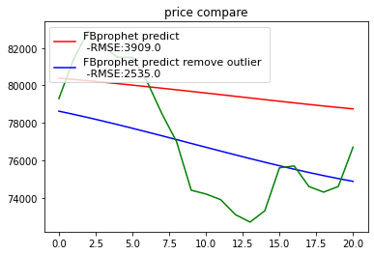
CONTENTS_1
CONTENTS_2
CONTENTS_3
CONTENTS_4
3. Prophet
[ RMSE 검증 결과 Plot ]

Slide 25
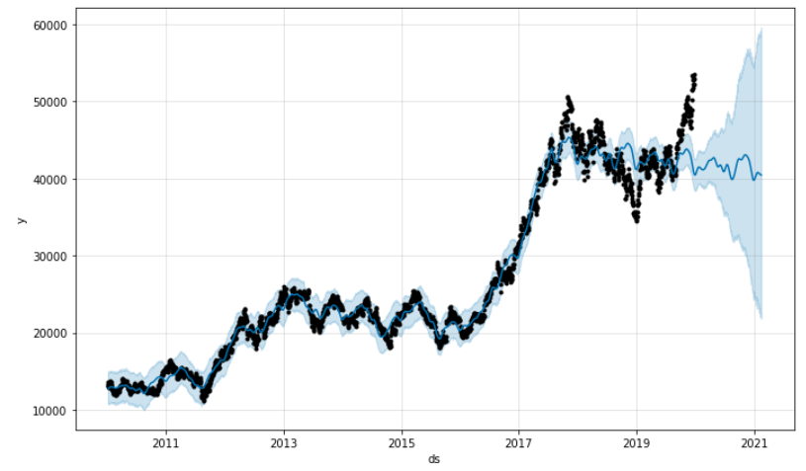
CONTENTS_1
CONTENTS_2
CONTENTS_3
CONTENTS_4
3. Prophet
[ 2010~2021 Data / 1Year 예측 ]

Slide 26
CONTENTS_1
CONTENTS_2
CONTENTS_3
CONTENTS_4
3. Prophet
[ Prophet Model 비교 ]

Slide 27
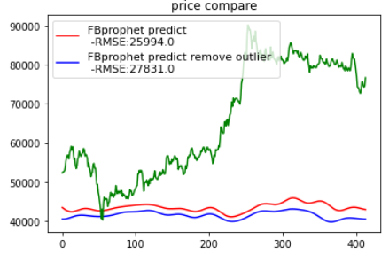
CONTENTS_1
CONTENTS_2
CONTENTS_3
CONTENTS_4
3. Prophet
[ Prophet Model 비교 ]

Slide 28
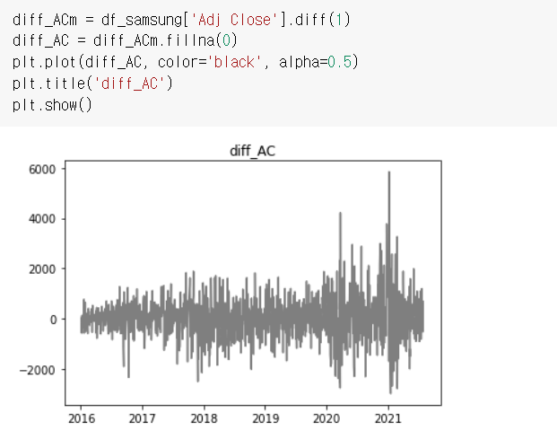
CONTENTS_1
CONTENTS_2
CONTENTS_3
CONTENTS_4
3. ARIMA
[ Differencing ]

Slide 29
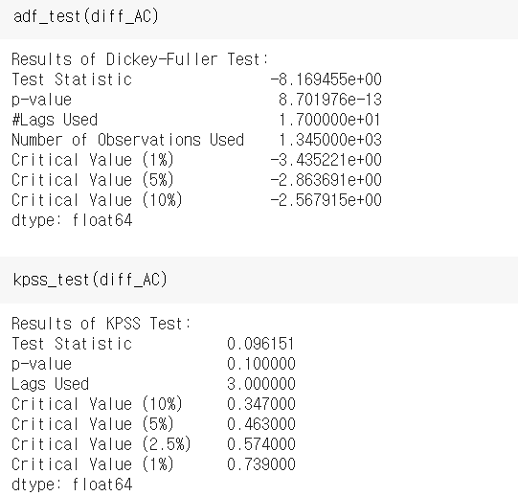
CONTENTS_1
CONTENTS_2
CONTENTS_3
CONTENTS_4
3. ARIMA
[ Differencing한 결과로 adf_test / kpss_test]

Slide 30
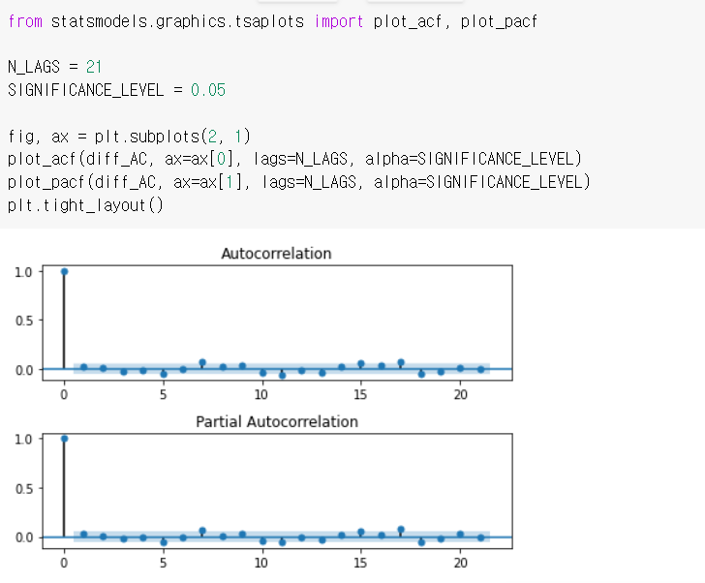
CONTENTS_1
CONTENTS_2
CONTENTS_3
CONTENTS_4
3. ARIMA
[ Data ACF / PACF]

Slide 31
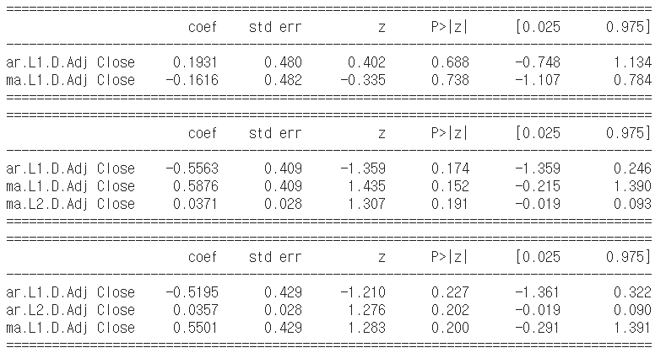
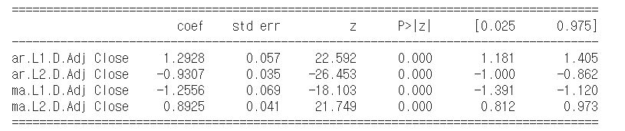
CONTENTS_1
CONTENTS_2
CONTENTS_3
CONTENTS_4
3. ARIMA
[ ACF, PACF TEST for diagnosis ARIMA(p,d,q)]

Slide 32

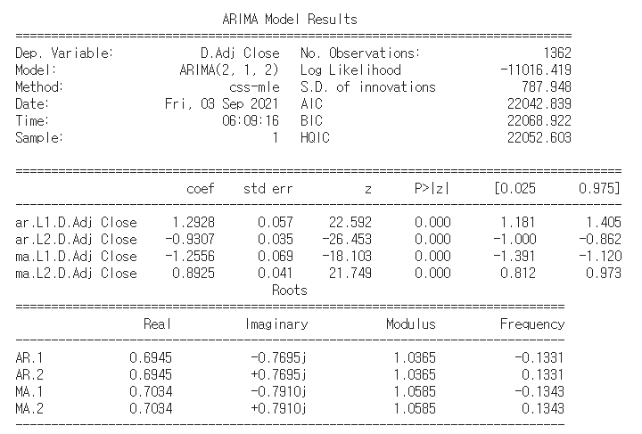
CONTENTS_1
CONTENTS_2
CONTENTS_3
CONTENTS_4
3. ARIMA
[ ARIMA Model : Data Differencing ]
[ ARIMA Model: Data 차분 _ Summary]

Slide 33
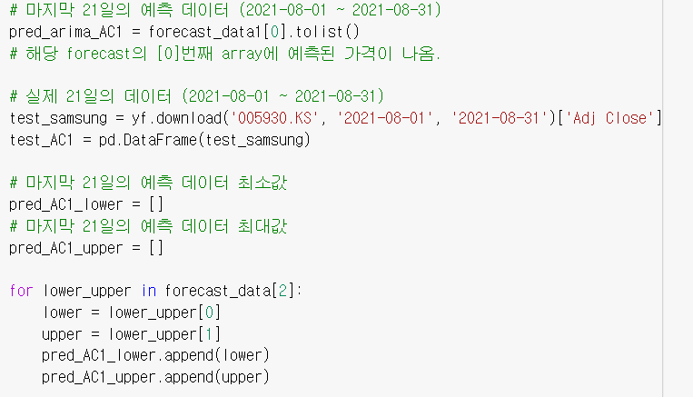
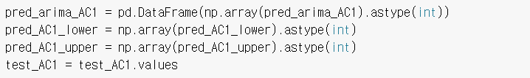
CONTENTS_1
CONTENTS_2
CONTENTS_3
CONTENTS_4
3. ARIMA
[ ARIMA Model : Data Differencing ]

Slide 34
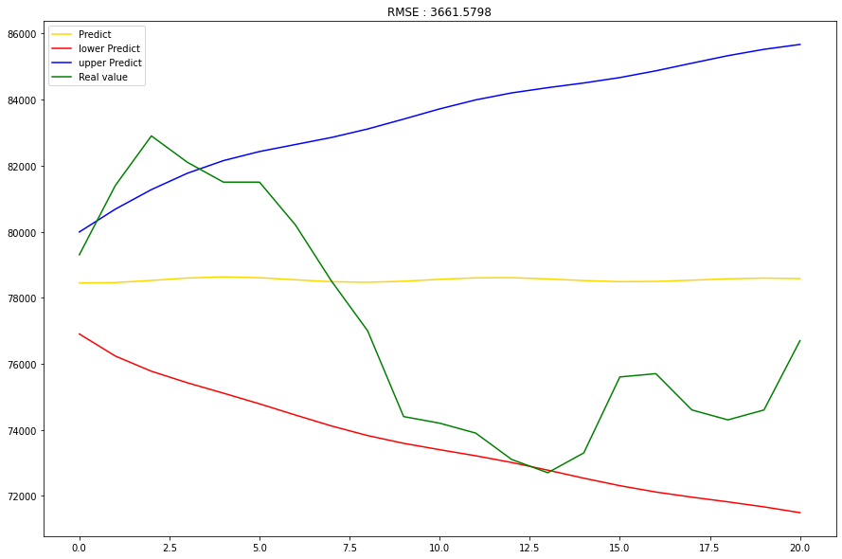
CONTENTS_1
CONTENTS_2
CONTENTS_3
CONTENTS_4
3. ARIMA
[ ARIMA Model 결과 Plot ]

Slide 35


CONTENTS_1
CONTENTS_2
CONTENTS_3
CONTENTS_4
3. ARIMA
[ Data log, Differencing 시행 ]

Slide 36
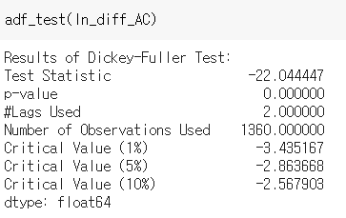
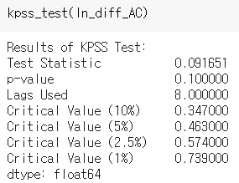
CONTENTS_1
CONTENTS_2
CONTENTS_3
CONTENTS_4
3. ARIMA
[ Data log, Differencing ADF / KPSS Test ]

Slide 37
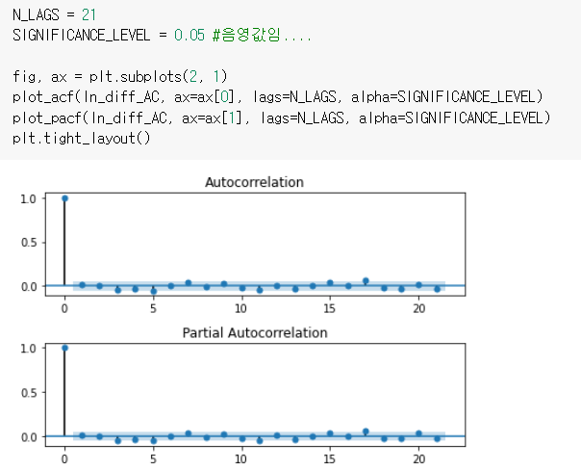
CONTENTS_1
CONTENTS_2
CONTENTS_3
CONTENTS_4
3. ARIMA
[ Data log, Differencing ACF / PACF ]

Slide 38
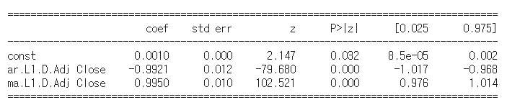
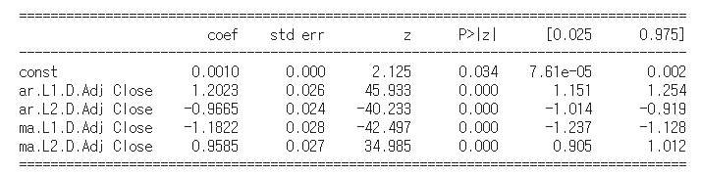
CONTENTS_1
CONTENTS_2
CONTENTS_3
CONTENTS_4
3. ARIMA
[ACF, PACF TEST for diagnosis ARIMA(p,d,q) ]

Slide 39
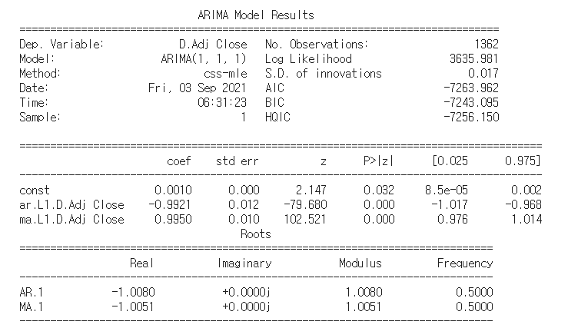
CONTENTS_1
CONTENTS_2
CONTENTS_3
CONTENTS_4
3. ARIMA
[ ARIMA Model : Data log, Differencing ]
[ ARIMA Model: Data 로그, 차분 _ Summary]

Slide 40
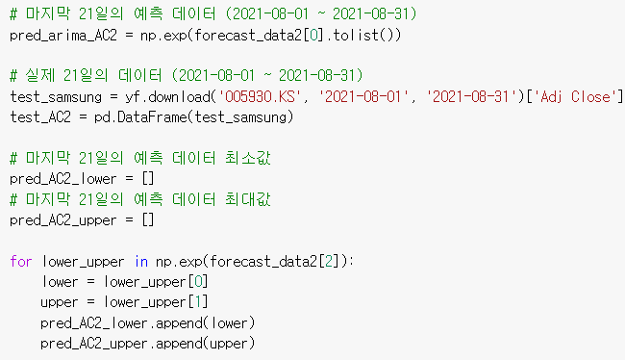
CONTENTS_1
CONTENTS_2
CONTENTS_3
CONTENTS_4
3. ARIMA
[ 1Month 예측: ARIMA Model (Data log, Differencing) ]

Slide 41
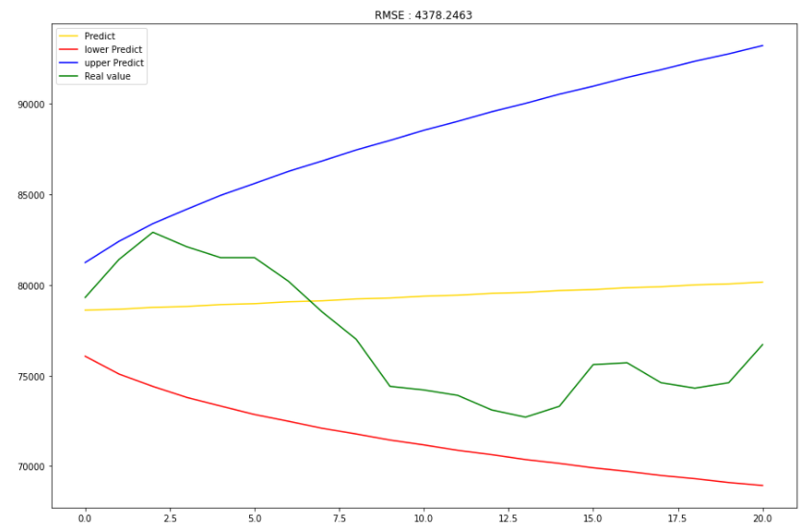
CONTENTS_1
CONTENTS_2
CONTENTS_3
CONTENTS_4
3. ARIMA
[ 1Month 예측: ARIMA Model (Data 로그, 차분) ]

Slide 42
CONTENTS_1
CONTENTS_2
CONTENTS_3
CONTENTS_4
3. ARIMA
[ ARIMA Model 결과 Plot ]

Slide 43
CONTENTS_1
CONTENTS_2
CONTENTS_3
CONTENTS_4
3. ARIMA
[ ARIMA Model 결과 Plot ]
[ 1Month 예측: ARIMA Model (Data 로그, 차분) ]

Slide 44



CONTENTS_1
CONTENTS_2
CONTENTS_3
CONTENTS_4
4. 시사점 및 결론

Slide 45
Thank You
감사합니다

